Slide 2


Notes:
I'm happy to realise that in whenever part of the world we meet we can speak the same language. We can speak TECHNOLOGY!
Vaimo Japan
Vietnam is one of our development centres

Slide 3
Practical insights into Building a fully automated code analysis flow
for your Magento project
Alec Bedzir
Head of Systems Architects - Vaimo
Notes:
I have a little bit pragmatic approach to conference presentations.
First, it should always be about some valuable take aways. Second, should be problem and solution.

Slide 4


Scope
Analysing various aspects (code style, performance, security etc.)
Static code analysis
Notes:
Two comments on the scope which we're going to discuss:
we will talk about Static analysis only
2. we don't talk about some particular analysis but about all of them in general

Slide 5



Code quality not measured
Problem
Don't know we're good or bad
Can't track the progress
Don't know what to improve
Don't know whom to mentor
Don't know who's the best
Team are not challenged

Slide 6
Reasons for not measuring code quality
operations wise
initial setup of code analysis tools is cumbersome
nobody is responsible explicitly
regular activities related to code analysis become a burden
confusion about how to transform analysis results in a set of actions
Notes:
Complex setup
No responsibility
Activities consume time
what exactly should we focus on?

Slide 7
Reasons for not measuring code quality (2)
motivation wise
no quick way to say quality is good or bad
comparing code quality on different projects is difficult
3rd party code makes final result bad anyway
customer is not explicitly interested in code quality
no task about measuring code quality on developer's JIRA board
Notes:
1. Are we good or bad?
2. Comparison is difficult
3. Influence of 3rd party code which we can't exclude
4. No direct support from business
5. No tasks

Slide 8



Implementing code analysis
Solution

Slide 9


Why not Jenkins
poor usability
cluttered interface
complex configuration
no in-depth security check
no thorough performance check
no issues ranking
no issues ownership
single score missing
Notes:
poor usability
cluttered interface
complex configuration
no in-depth security check
no thorough performance check
no issues ranking
no issues ownership
single score missing

Slide 10
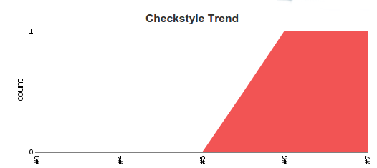
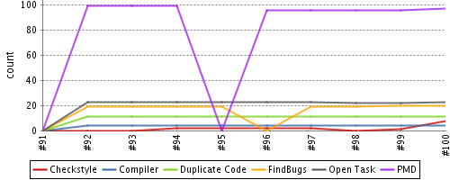

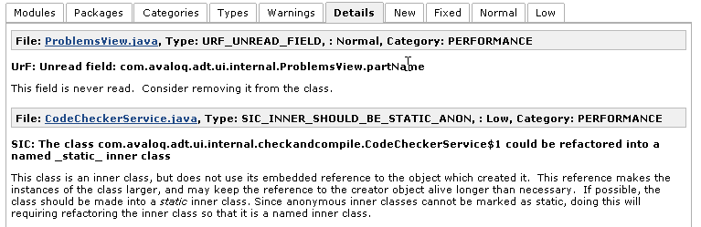
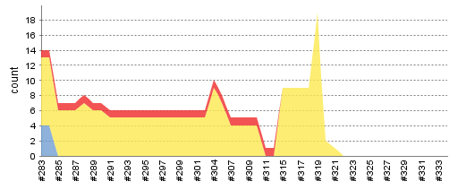
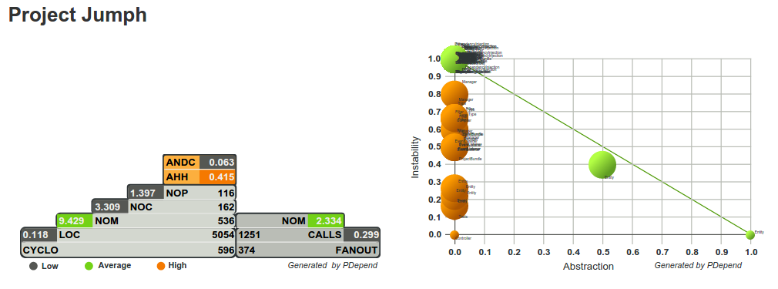
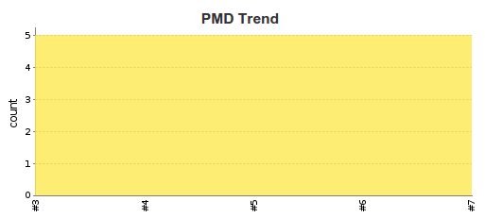

Slide 11

No Jenkins at all?
at Vaimo we still use Jenkins as automation server
meaning that we utilize Jenkins a lot for building and deploying projects as well as for running numerous maintenance and infrastructure related jobs

Slide 12

What instead?

Slide 13







PhpMetrics

Slide 14
Strategy
make it "no actions required" feature available out of box
make it possible to change analysis scope and rules per project
ensure code quality level is communicated in a simplest form
make it easy and fast to grasp current code quality level
Notes:
No actions required approach
Flexible scope
Simple final score
Way to check the score quickly
4DX by FranklinCovey

Slide 15
Strategy (2)
deliver analysis results in a form of JIRA tasks on dedicated board
filter out and sort code analysis tasks automatically
make team responsible for the code quality JIRA board
create competition around code quality score
Notes:
Results as JIRA issues
Filter irrelevant items automatically
Accountability
Competition

Slide 16
Requirements
small setup and configuration efforts
supporting numerous repositories at reasonable costs
possibility to change the analysis scope
possibility to influence results (filtering, sorting etc.)
simple score indicating the code quality level
Notes:
Quick setup and configuration
Sufficient capacities
Changeable scope
Influencing results
Simple score format

Slide 17
Requirements (2)
granular access granting system
API access
clean and intuitive interface
mercurial support
automatic analysis of dependencies
Notes:
Controlled flexible access
API
interface
Mercurial
Automatic analysis of dependencies

Slide 18



checks
Best Practice
Bug
Coding Style
Compatibility
Comprehensibility
Deprecated Code
Documentation
Duplication
Naming
Performance
Security
Unused Code
Severity

Slide 19

other features
introduced by
hot spots
severity levels
quality score
automatic patches
filtering false-positives
scheduled & hook based inspections
3rd party checks support
automatic analysis of dependencies
... many more at https://scrutinizer-ci.com

Slide 20







Fully automated analysis flow
Jenkins job for project converting (HG to GIT)
Jenkins job for project analysis
Push to Bitbucket
repo
Triggering analysis in Scrutinizer
Creating issues on JIRA board
Notes:
Building the project
Converting to GIT
Pushing to repo which triggers analysis
Delivering results to JIRA board via two API`s

Slide 21




Fully automated analysis flow
Controlled by Jenkins
Hg
project
name
job "generate_project"
GIT
building with composer

Slide 22



Fully automated analysis flow
(via "Push Tracking")
starts analysis
generates report
GIT
Scrutinizer
& JIRA API
Jenkins job
issues on board

Slide 23
Glossary
phploc can quickly measure the size of a PHP project
pdepend can generate a large set of software metrics from a given code base. These values can be used to measure the quality of a software project and they help to identify the parts of an application where a code refactoring should be applied
phpmd scans PHP source code and looks for potential problems such as possible bugs, dead code, suboptimal code, and overcomplicated expressions

Slide 24
Glossary (2)
phpcpd is a Copy/Paste Detector (CPD) for PHP code. It scans a PHP project for duplicated code
phpcs tokenises PHP, JavaScript and CSS files and detects violations of a defined set of coding standards. It is an essential development tool that ensures your code remains clean and consistent. It can also help prevent some common semantic errors made by developers
phpDox is the documentation generator for PHP projects. This includes, but is not limited to, API documentation

Slide 25
Resources
https://wiki.jenkins-ci.org
https://www.sitepoint.com/analyzing-php-project-jenkins/
http://phpqatools.org/
http://www.4dxbook.com/
https://scrutinizer-ci.com

Slide 26
Alec Bedzir
Head of Systems Architects - Vaimo
alec.bedzir@vaimo.com

